Slide 1
Android Permission Model
2018/06

Slide 2
Contents
Basic
Android Permission
Custom ROM
Problem

Slide 3
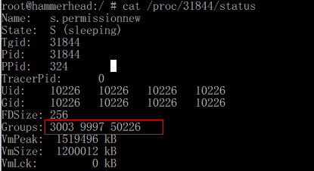

Basic : sandbox
User ID - Each application has a unique User ID
Group ID - Each User ID has a unique Group ID, and this Group ID may belong to members of other GroupID
Groups - Each Group ID belongs to certain groups such as inet for internet, sdcard_rw for External storage read-write, etc.

Slide 4
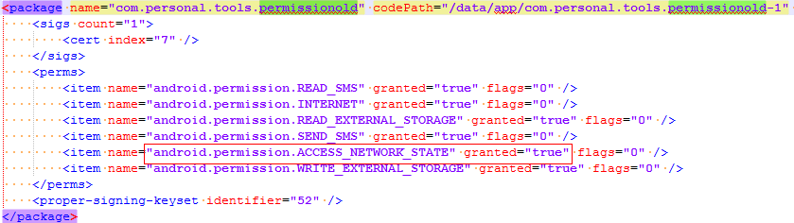
Android Permission
Android M Less
Install Permission
/data/system/packages.xml

Slide 5
Android Permission
Android M 6.0
Permission Category
Normal , Dangerous
frameworks/base/core/res/AndroidManifest.xml
Frameworks/base/data/etc/platform.xml
System/core/include/private/android_filesystem_config.h

Slide 6
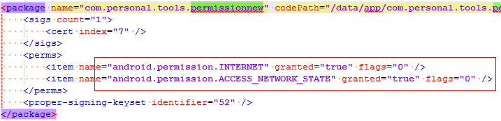
Android Permission
Install Permission
/data/system/packages.xml

Slide 7
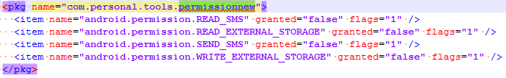
Android Permission
Runtime Permission
/data/system/users/0/runtime-permissions.xml

Slide 8
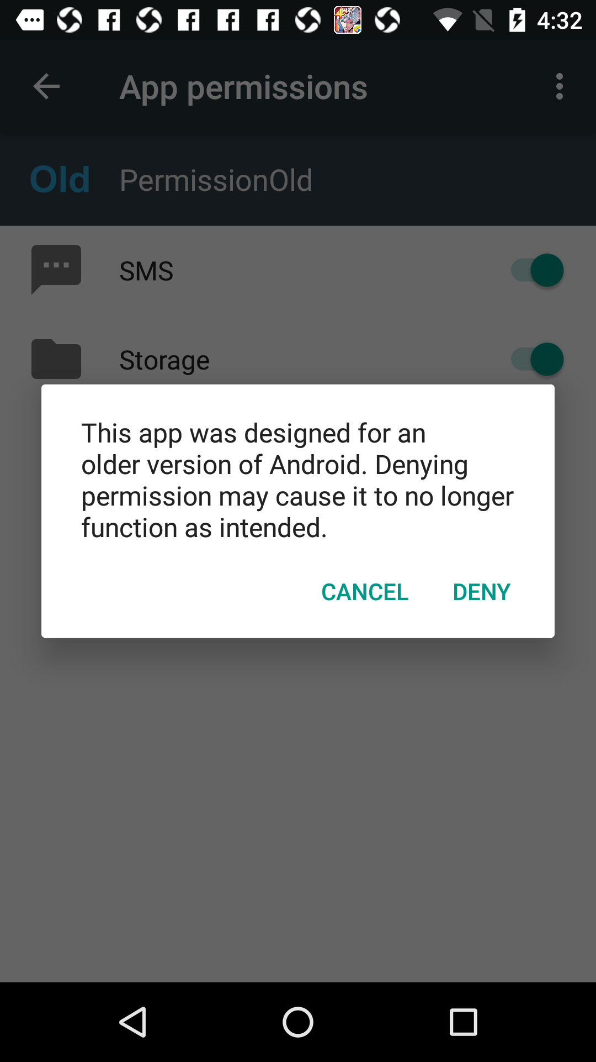
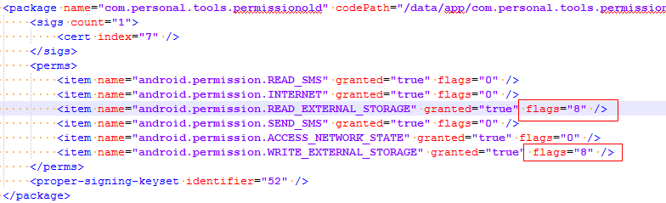
Android Permission
Compatible
App target sdk version < 23 run on Android 6.0

Slide 9
Custom ROM
Security Center

Slide 10
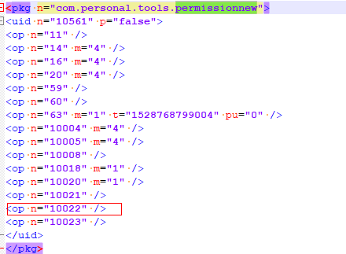
Custom ROM
/data/system/appops.xml

Slide 11
Problem
Installed Packages List Permission
Installed Packages
File : /data/system/packages.xml
Memory : PackageManagerService system_service

Slide 12
Problem
Xposed

Slide 13
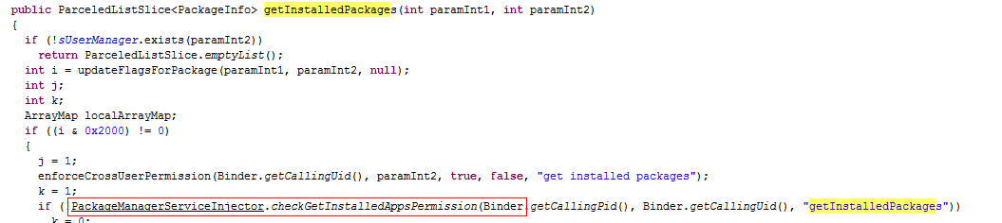
Problem
Custom ROM : MI 7.0

Slide 14
THANKS

Slide 15
Basic
a unique user and group ID
Permission system
API Level 23 install vs runtime
Normal Permissions:network
Dangerous Permissions:read users contact data
Runtime Permissions

Slide 16
Model
MI 7.0
HW 6.0.1
Google NEXUS 6.0.1
https://blog.csdn.net/lewif/article/details/49124757

Slide 17
AndroidManifest
<uses-permission android:name="android.permission.INTERNET" />

Slide 18
p.getInstalledPackages(PackageManager.GET_PERMISSIONS | PackageManager.GET_PROVIDERS)

Slide 19
pm command
adb shell pm list packages
adb shell pm list packages -f
adb shell pm list packages -s system app
adb shell pm list packages -3 third app
adb shell pm list packages -d
adb shell pm list packages -e

Slide 20
Application API
checkSelfPermission
shouldShowRequestPermissionRationale
requestPermissions
onRequestPermissionsResult

Slide 21
packages.xml
/data/system/packages.xml
PMS
<permissions>
package=”android” system permission
package=”package name” application permission

Slide 22
odex => jar
java -jar baksmali.jar d settings.odex
java -jar smali.jar a out -o setting.dex
d2j-dex2jar.bat settings.dex

